Slide 1
ENVIRONMENT POLLUTION

Slide 2
What is Environmental pollution?
Environmental pollution is the introduction of foreign and potentially harmful elements into the environment. The consequences are particularly important when they damage ecosystems and human societies, especially with regard to health. Pollution is not a human prerogative: volcanoes, for example, also emit pollutants.
Types of pollution
Water Pollution
Air Pollution
Soil Pollution
Noise pollution

Slide 3
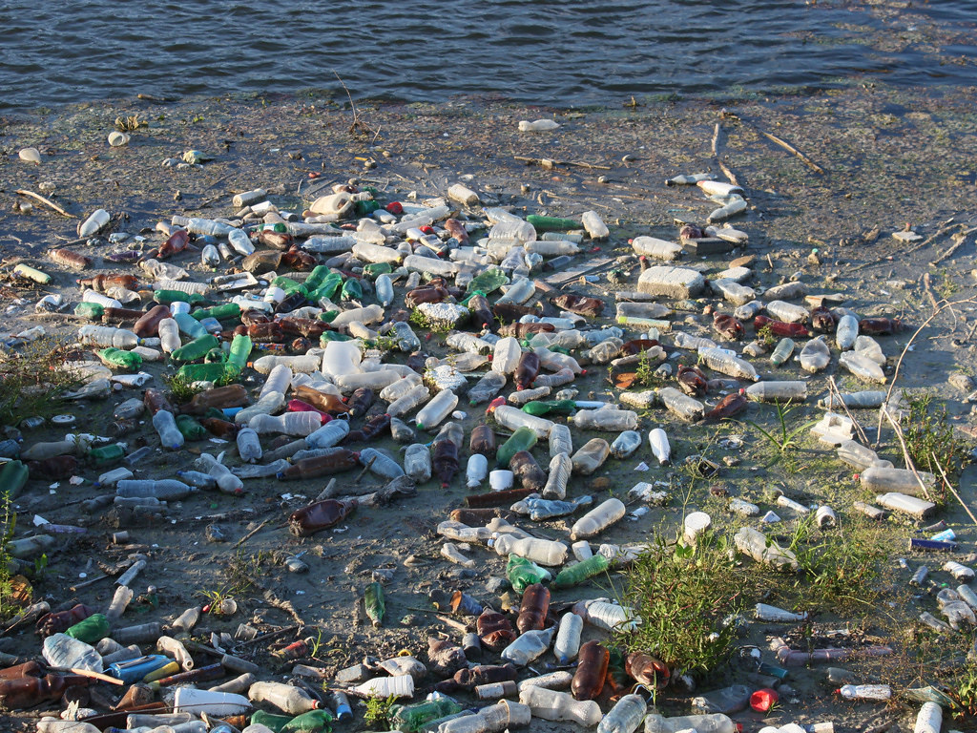
Water Pollution
Water pollution occurs when harmful substances, like chemicals, waste, or oil, enter rivers, lakes,
and oceans. These pollutants make the water unsafe for drinking, bathing, and wildlife.
It can happen from industrial waste, agricultural runoff, or untreated sewage.
Contaminated water harms aquatic life and can spread diseases.
Water pollution also disrupts ecosystems and food chains. It poses a serious threat to human health
and the environment. Reducing waste and proper treatment of water can help prevent pollution.
This Photo by Unknown Author is licensed under CC BY
Fig: water pollution

Slide 4
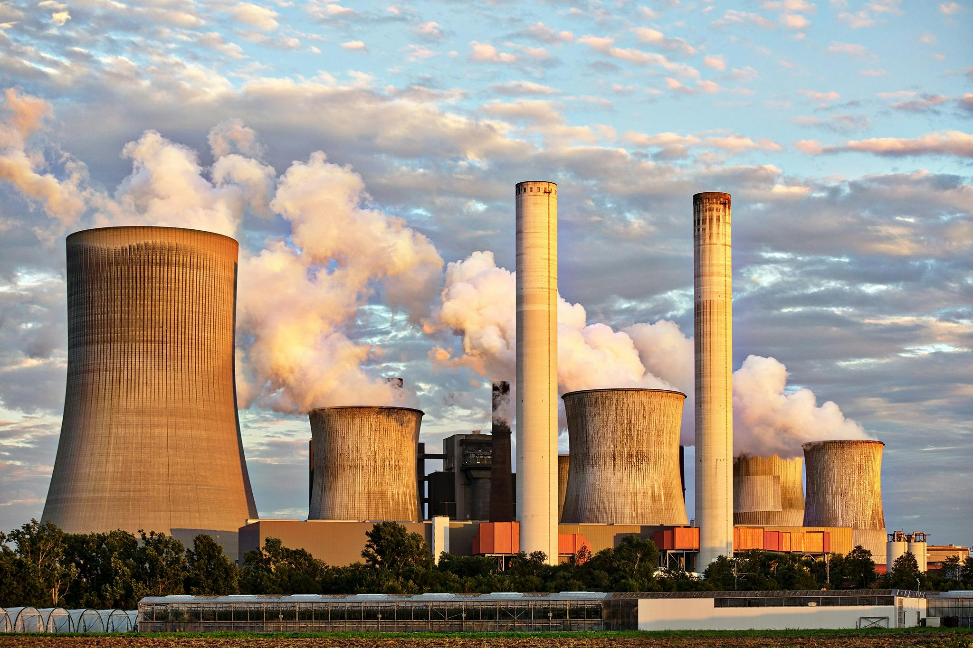
Air Pollution
Air pollution is the presence of harmful substances in the air, caused by human activities like
industrial emissions, transportation, and agriculture, as well as natural events like wildfires.
Major pollutants include particulate matter, nitrogen oxides, sulfur dioxide, and carbon monoxide.
It can lead to respiratory and heart diseases, worsen asthma, and cause premature death.
Air pollution also harms ecosystems, contributes to acid rain, and accelerates global warming.
Poor air quality affects visibility, crops, and buildings. Solutions involve cleaner energy, stricter
regulations, and public awareness.
Fig: Air pollution

Slide 5
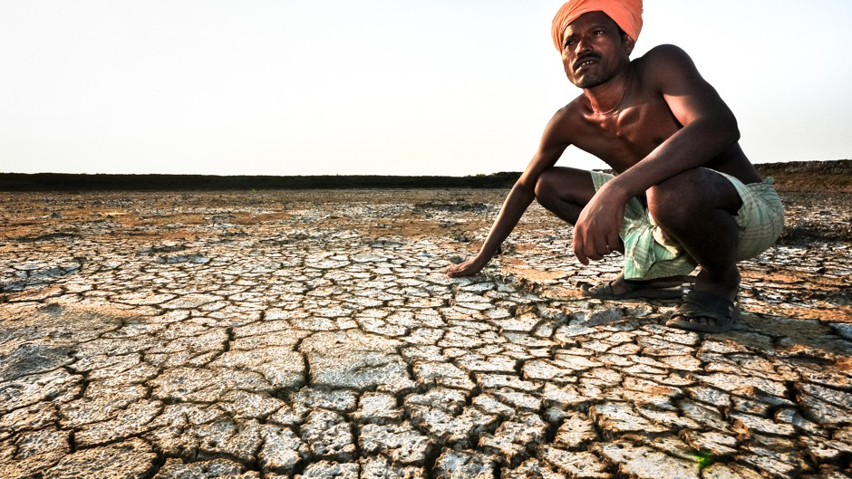
Soil Pollution
Soil pollution is the contamination of soil by harmful substances like chemicals, heavy metals, and
waste, primarily due to industrial activities, agriculture, improper waste disposal, and mining.
It results in decreased soil fertility, harming plant growth and reducing food production. Polluted
soil can also threaten wildlife, contaminate water sources, and pose health risks to humans. Major
causes include pesticide use, plastic waste, and oil spills. The effects include soil erosion, loss of
biodiversity, and long-term environmental damage. Solutions include sustainable farming,
waste recycling, reforestation, and stricter regulations. Bioremediation can
also help restore contaminated soils.
Fig: Soil pollution

Slide 6

Noise pollution
Noise pollution is the excessive or disruptive sound in the environment that negatively
impacts human health and wildlife. It is primarily caused by traffic, industrial activities,
construction work, loud music, and social events. The effects include hearing loss,
stress, sleep disturbances, reduced productivity, and harm to animals’ natural behavior.
To mitigate noise pollution, solutions include enforcing noise control laws, using soundproof
materials, promoting quieter technologies, and planting trees to absorb sound. Raising public
awareness and encouraging responsible behavior are also crucial steps in reducing noise pollution.
Fig: Noise Pollution

Slide 7
THANK YOU

